Slide 1
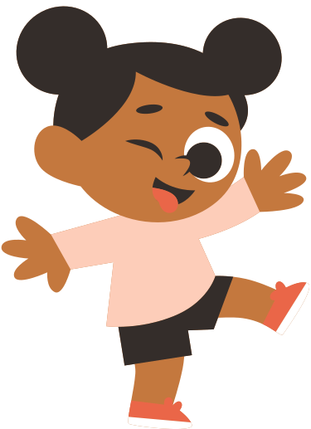
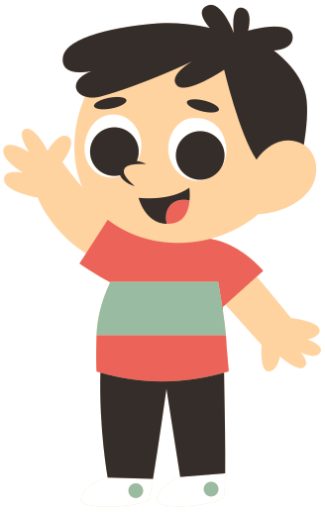
PRESENT
SIMPLE
TENSE
GRAMMAR PRESENTATION BY MR. STEFANO

Slide 2


WHEN TO USE?
We use Present Simple Tense to express
universal facts.
Examples:
Two and two make four.
The Earth revolves around the Sun.

Slide 3
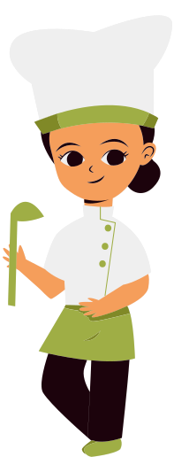
WHEN TO USE?
We use Present Simple Tense to express
permanent situations.
Examples:
I live in Nay Pyi Taw.
She works in a restaurant.

Slide 4
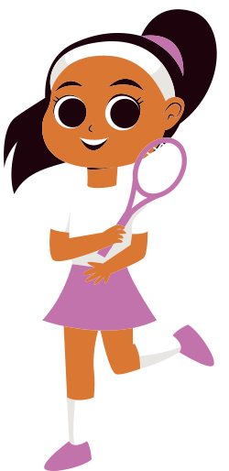
WHEN TO USE?
We use Present Simple Tense to express
habits and routines.
Examples:
I play tennis at the weekend.
My dad washes his car every Sunday.

Slide 5
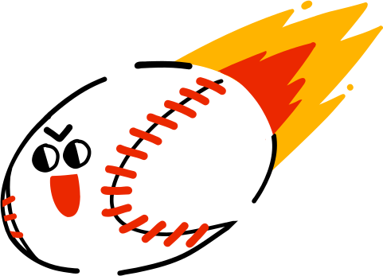
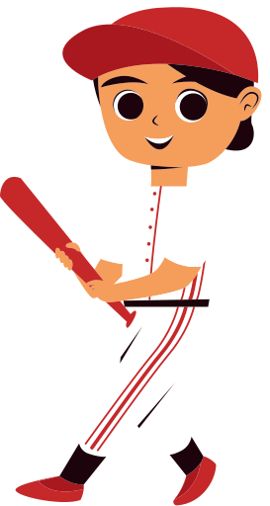
WHEN TO USE?
We use Present Simple Tense to express
short actions now.
Examples:
Now I understand why.
He hits the ball hard!

Slide 6

WHEN TO USE?
We use Present Simple Tense to express
future timetables.
Examples:
The train leaves at 11 am.
What time does the plane arrive?

Slide 7
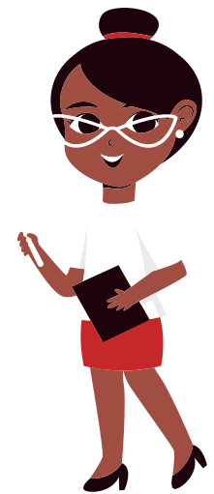
WHEN TO USE?
We use Present Simple Tense to express
future in time clauses.
Examples:
She won't go out until it stops raining.
We'll play a game after I teach you this.

Slide 8

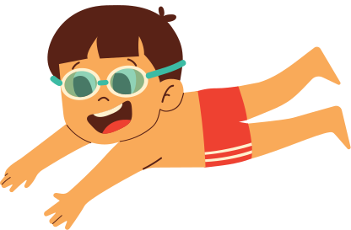
HOW TO FORM?
We form Present Simple Positive like this:
I swim.
You swim.
We swim.
They swim.
He swims.
She swims.
It swims.
Third person
singular subjects take
-s, -es or -ies.

Slide 9

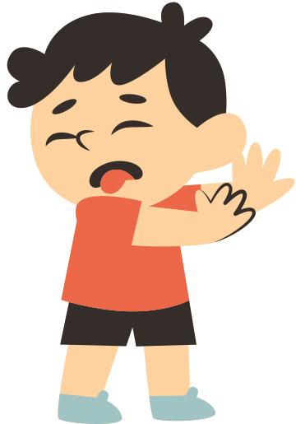
HOW TO FORM?
We form Present Simple Negative like this:
I don't eat meat.
You don't eat meat.
We don't eat meat.
They don't eat meat.
He doesn't eat meat.
She doesn't eat meat.
It doesn't eat meat.
Third person
singular subjects take
doesn't.

Slide 10

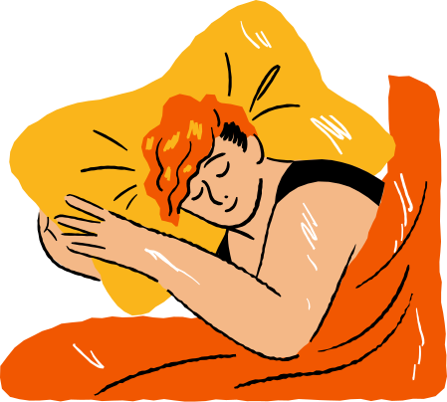
HOW TO FORM?
We form Present Simple Question like this:
Do I sleep?
Do you sleep?
Do we sleep?
Do they sleep?
Does he sleep?
Does she sleep?
Does it sleep?
Third person
singular subjects take
does.

Slide 11
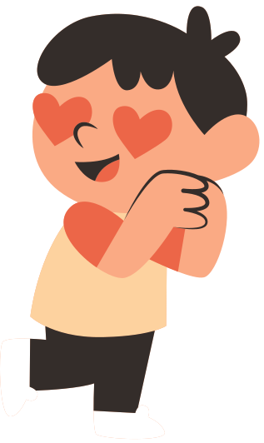
HOW TO FORM?
We form short answers like this:
Positive Short Answers
Negative Short Answers
Yes, I / you / we / they do.
Yes, he / she / it does.
No, I / you / we / they don't.
No, he / she / it doesn't.

Slide 12

Exercises
Start
a)
Mechanics usually ____ work at nine o'clock.
Starts
b)
See
c)
Enjoys
d)

Slide 13
Start
a)
Starts
b)
See
c)
Enjoys
d)

Slide 14
Open
a)
The village bank ____ at eight o'clock in the morning.
Starts
b)
Opens
c)
Opened
d)

Slide 15
Open
a)
Starts
b)
Opens
c)
Opened
d)

Slide 16
Like
a)
Children usually ____ watching cartoons on TV.
Likes
b)
Liking
c)
Liked
d)

Slide 17
Like
a)
Likes
b)
Liking
c)
Liked
d)

Slide 18


Slide 19
THANK
YOU!

